Slide 1
QUALITY AND YOU
GUIDE for New Medical Staff

Slide 2
WHO’S WATCHING?
The Public
CMS
Insurers
The Joint Commission
Georgia Medical Care Foundation
Others (NHSN, Leapfrog, etc…)

Slide 3
GOALS
Highest quality of care at an acceptable price
Patient satisfaction
Excellent outcomes
Receive bonuses and avoid financial penalties
Meet publicly available measures and scores of
quality

Slide 4
50

Slide 5
System Quality Performance
Quarterly Activities: Data submission to various organizations and agencies
Coverdell
Georgia Registry of Immunization Transactions and Services (GRITS)
Get With The Guidelines (GWTG)
Leapfrog
Society of Thoracic Surgeons (STS)
The Joint Commission
American Heart Association (AHA)
Association for Healthcare Research and Quality (AHRQ)
Blue Cross/ Blue Shield Quality In-Sights Hospital Incentive Program (Q-HIP)
American College of Cardiology (ACC)-Percutaneous Cardiovascular Intervention (PCI) and Implantable Cardioverter Defibrillator (ICD)
Center for Medicare and Medicaid Services (CMS)

Slide 6
Inpatient Quality Measures
Flu vaccine (October 1 to March 30)
Sepsis measures
Stroke measures
Tobacco cessation
Specific measures for specific specialists (OB, thoracic surgeons, cardiologists, ER doctors, neurologists)
50

Slide 7
CMS OUTPATIENT
PROJECT
AMI
Chest Pain
Colonoscopy timing
Emergency Department
Outpatient Surgery
Pain Management
Long Bone Fractures
Stroke
Radiation of Bone Metastases

Slide 8
Hospitalist Specific Measures
VTE prophylaxis (in flux)
AMI, CHF, pneumonia readmissions
Stroke measures

Slide 9
Stroke Measures
Swallow eval before ANY po (including ASA)
NIH stroke scale in first 48 hours (or before TPA)
Early antithrombotics AND at discharge
VTE prophylaxis
Anticoagulants for afib/flutter at discharge
Smoking cessation
Statin therapy
LDL documented
Stroke education
Rehab considered
50

Slide 10
Identification & Treatment of Severe Sepsis and Septic Shock Based on the CMS Sepsis Core Measure and guidelines October 2015 | Identification & Treatment of Severe Sepsis and Septic Shock Based on the CMS Sepsis Core Measure and guidelines October 2015
Severe Sepsis/Septic Shock Definitions | Treatment Overview
Severe Sepsis Present when the following three are met within 6 hours of each other ● Presence of infection/suspected infection ● Two or more Systemic Inflammatory Response Syndrome (SIRS) criteria ° Temp > 101 F (38.3° C) or < 96.8° F (36° C) ° HR > 90 bpm ° RR > 20 per min ° WBC >12,000 or < 4000 or > 10% Bands ● One or more signs of organ dysfunction (organ dysfunction caused by a chronic condition or medication is not included) ° Lactic Acid > 2 and < 4 ° Hypotension = SBP < 90 or MAP < 65 or a decrease in SBP by > 40 from last considered normal for patient ° Creatinine > 2 ° Urine output < 0.5ml/kg/hr x 2 hrs ° Bilirubin > 2 mg/dl ° PLT count < 100,000 ° INR > 1.5 ° PTT > 60 ° Acute respiratory failure requiring - a new need for invasive or non-invasive mechanical ventilation | After identification of Severe Sepsis/Septic Shock, patient receives all of the following Within 3 hours of presentation time ● Lactic acid – initial specimen collected and resulted ● Blood Culture prior to IV antibiotics – specimen collected ● Crystalloid fluid bolus (30ml/kg Lactated Ringers (LR) or 0.9% NaCl (NS) initiated – if hypotension present and/or initial lactic acid > 4. Within 6 hours of presentation time (not from last evaluation but from presentation of Severe Sepsis) ● Repeat lactic acid – if initial level > 2
 | If Septic Shock identified, patient receives the following in addition to those listed above Within 6 hours of presentation time ● Focused exam, Physician/APRN/PA note that is documented after the crystalloid fluid bolus was started and must include all of the following ° Review of VS: must include temp, HR, RR, and BP. Nursing my obtain ° Cardiopulmonary evaluation: Includes heart and lung evaluations. Performed by Physician/APRN/PA ° Capillary refill: Performed by Physician/APRN/PA ° Peripheral pulse evaluation: Performed by Physician/APRN/PA ° Skin exam: Includes reference to skin pallor, performed by Physician/APRN/PA
Septic Shock present when both of the following are met within 6 hours of each other ● Patient meets Severe Sepsis criteria above ● Either: ° Lactic acid > 4 ° Persistent hypotension
*** Persistent hypotension occurring the hour after crystalloid fluid bolus. Persistent hypotension = two or more consecutive SBP reading of , <90 or MAP < 65 or decrease in SBP by 40 from last SBP considered normal for patient in the hour following the crystalloid bolus Notes ● If clinical criteria for severe sepsis/septic shock are not met, Physician/APRN/PA documentation of Severe Sepsis/Septic Shock will be designated as the presentation of time ● If clinical criteria are met prior to Physician/APRN/PA documentation, the presentation time will be the time that the last criteria is met | If Septic Shock with persistent hypotension ***, also receives within 6 hours ● Vasopressors – Initiated, must include one/more of the following ° Norepinephrine (LEVOPHED), phenylephrine (NEOSYNEPHRINE), dopamine, epinephrine, vasopressin (PITRESSIN) *** Persistent hypotension occurring the hour after crystalloid fluid bolus. Persistent hypotension = two or more consecutive SBP reading of , < 90 or MAP < 65 or decrease in SBP by 40 from last SBP considered normal for patient in the hour following the crystalloid bolus

Slide 11
Sepsis Measures - Summary
1st Lactic acid, blood cultures, antibiotics in three hours
If hypotensive or lactic acid >2, 30 ml/kg in first three hours
Second lactic acid within six hours
Follow up exam after fluid for septic shock
No vasopressors till after fluids

Slide 12
Tobacco Cessation Measures for Joint Commission
Tobacco use screening
Tobacco use treatment provided or offered
Tobacco use treatment
Tobacco use treatment provided or offered at discharge
Tobacco use treatment at discharge

Slide 13
What is Value Based Purchasing
This is a program of CMS to reward and penalize good and “less than optimal” care of patients.
This has morphed each year since inception.
The most recent focus is on outcomes, patient satisfaction, process of care, safety, and efficiency and cost reduction.

Slide 14
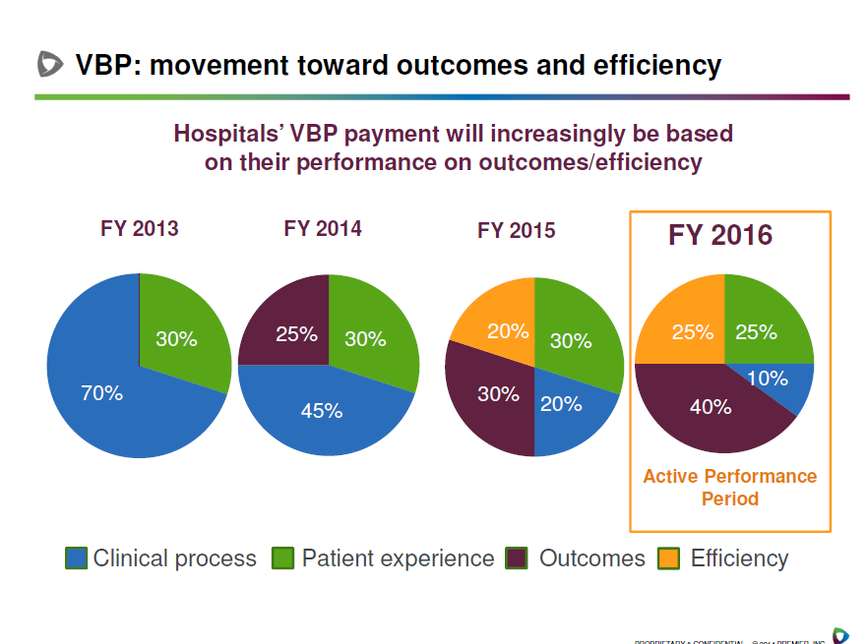
50

Slide 15
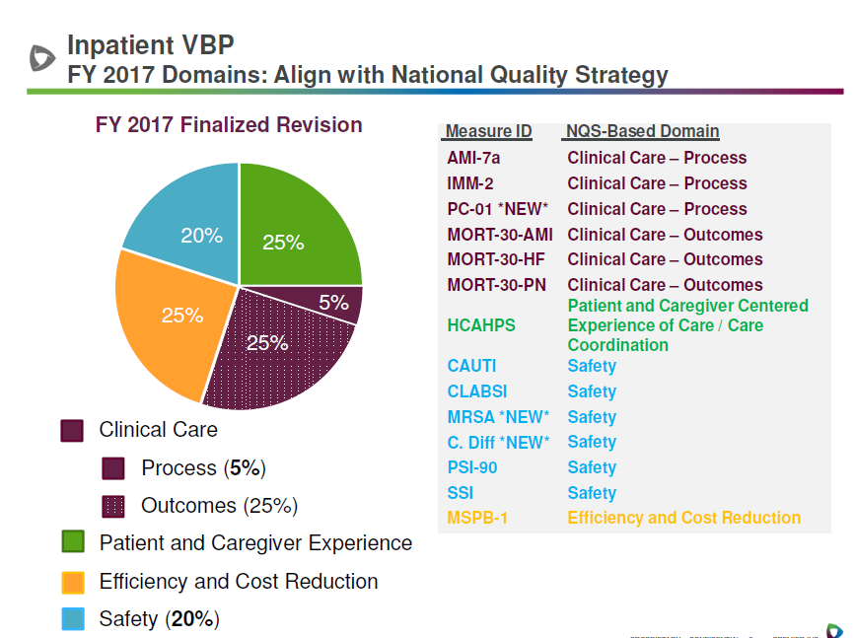
50

Slide 17
Value Based Purchasing Spending per Beneficiary
Length of stay is primary contributing factor to MSPB
Includes three days prior and thirty days after acute discharge
Considerations include home, home health, rehab, SNF, LTAC
Early AM discharge greatly helps ED throughput, and consequently patient satisfaction

Slide 18
Value Based Purchasing Clinical Outcomes
30-day mortality, acute myocardial infarction
30-day mortality, heart failure
30-day mortality, pneumonia

Slide 19
REDUCING MORTALITY
Document, Document!!
Use Sepsis Bundle Promptly
Order Sets
Involve Palliative Care, Ethics Committee,
Hospice Care when appropriate!
When Appropriate, write orders for Comfort Care and DNR

Slide 20
Value Based Purchasing- HCAHPS Hospital Consumer Assessment of Healthcare Providers and Systems
Communication with Doctors
Communication with Nurses
Responsiveness of Hospital Staff
Pain Management
Communication about Medications
Hospital Cleanliness and Quietness
Discharge Information
Overall Rating of Hospital

Slide 21
Value Based Purchasing-Safety
PSI-90
Central Line Associated Bloodstream Infections
Catheter Associated Urinary Tract Infections
Surgical Site Infections: Colon and Abd. Hyst.
MRSA bacteremia
C.Difficile Infections (hospital acquired)
Elective delivery before 39 weeks gestation

Slide 22
Healthcare Acquired Conditions
This is a penalty on the lowest performing 25% of hospitals, and represents 1% of their Medicare payment.
Measures: (very similar to VPB safety measures)
PSI-90
Infections acquired IN the hospital (CLABSI, CAUTI, MRSA, C.diff, SSIs of colon and abd. Hysterectomy)

Slide 23
What is PSI-90?
Pressure Ulcers
Iatrogenic Pneumothorax
CLABSI
Accidental Puncture or Laceration Rate
Post-op Hip Fracture Rate
Post-op DVT or PE
Post-op Sepsis
Post-op Wound Dehiscence Rate

Slide 24
Readmission penalty
Can be up to 3% of total Medicare dollars.
Applies to diagnoses of:
1) CHF
2) AMI
3) Pneumonia

Slide 25
How Can Physicians Decrease HACs?
Fewer central lines, more midlines
Avoid femoral lines, and change or remove ASAP or within 24 hours at the latest
No stitching of central lines
Any loose stool, order C.diff on admission
Careful op note dictation (for clarification, speak with Dr. Scott)
Order or support nurse driven urinary catheter removal
Careful DVT prophylaxis
IJ’s instead of subclavian lines

Slide 26
What Would We Like You To Do?
Be aware of measures under scrutiny
Use order sets as frequently as possible that have been
vetted as “best practice” and include quality measures.
Be open to suggestions from St. Joseph’s/Candler colleagues about drug choices, clarification of diagnosis, etc…
Do all medical records in a timely fashion.

Slide 27
QUESTIONS?
Put me in your cell phone:
Julia L. Mikell, MD
Director, System Quality Performance
Office: 912-819-8558
Cell: 912-507-1501
Email Address: drmike@sjchs.org

Slide 34
50

Slide 35
50

